Slide 1
Multipath TCP
BLG 632E - Next Generation Wireless Networks
Tugrul Yatagan

Slide 2
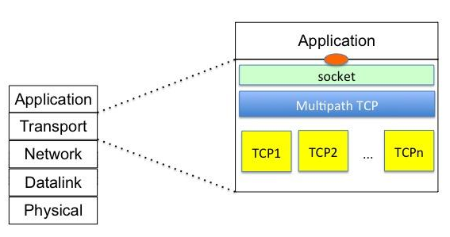
What is mpTCP?
Multipath TCP provides the ability to simultaneously use multiple paths between peers.
Handles mobility at transport layer.
Offers the same type of service to applications as TCP, like reliable stream.
Currently being standardised in the IETF.
Backward compatible with TCP.
mpTCP client can communicate with a TCP host
https://en.wikipedia.org/wiki/File:Multipath_TCP_architecture.jpg

Slide 3
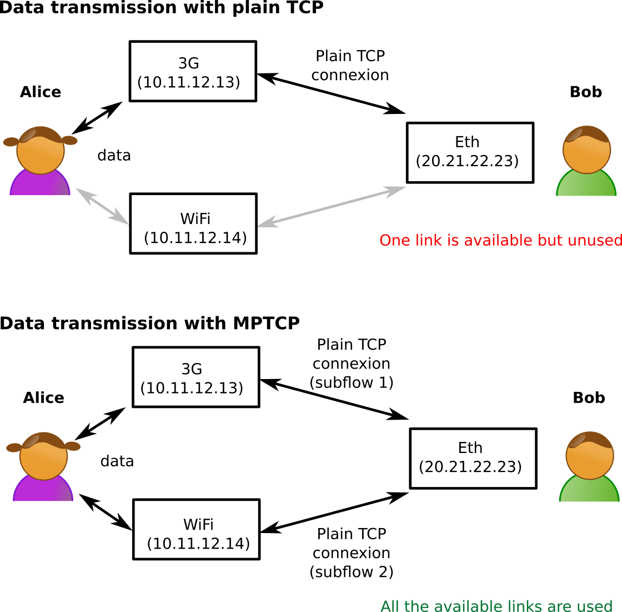
What is mpTCP?
“make-before-break” architecture
A make-before-break handoff is basically the acquisition of a new interface/IP address while the current one is working.
Possible for a mobile host to move seamlessly between networks. (even between IPv4 and IPv6)
Mobile IP hasn’t been supported by operators
Mobile IP tries to solve mobility at IP layer.
Mobile IP has no access to the information needed to perform optimally in make-before-break.
https://en.wikipedia.org/wiki/File:DifferenceTCP_MPTCP-en.png

Slide 4
How mpTCP works?
There are two basic mobility events:
new interface is available
existing interface ceases to be available
A connection is initiated by the mobile host performing the TCP 3-way handshake
When a new interface becomes available and an IP address is acquired, It adds the new IP address to the established MPTCP connection.
A new TCP 3-way handshake is performed using the new IP address as source address.
This new connection is identified as a subflow of the ongoing connection
MPTCP connection has two subflows using the original IP address and the new IP address of the mobile host
MPTCP keeps track of the data exchanged through each interface and perform flow control, congestion control, error detection and retransmissions accordingly.

Slide 5
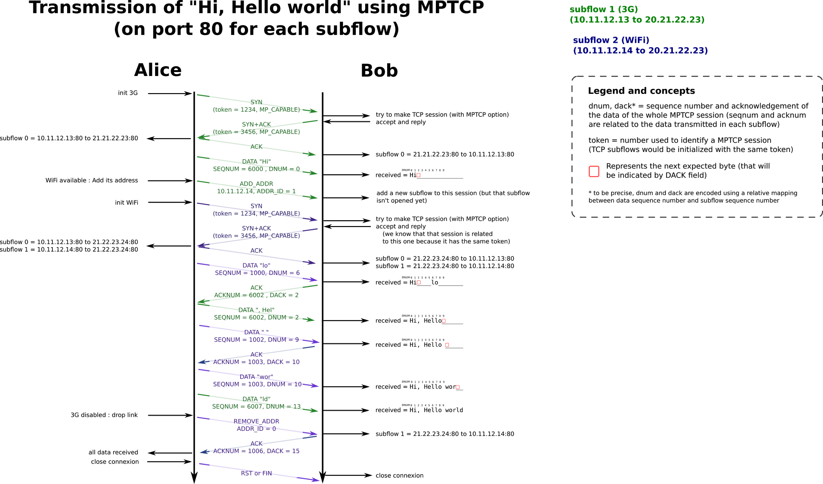
https://upload.wikimedia.org/wikipedia/commons/f/f3/MPTCP-session-en.png

Slide 6
What advantages mpTCP has?
If an interface on the mobile host goes down, all subflows associated with that interface stop transferring data.
Any other subflows continue exchanging data and will retransmit any missing data that was in flight on the failed subflows.
Benefits of MPTCP for mobile devices lie in the ability to overlap use of more than one radio.
Since, It is possible for a mobile host to move seamlessly between networks,
MPTCP can be used for maintain application session with a mobile node (MN) whose IP point of attachment to the network changes during the application session.

Slide 7
Thank you!

